Slide 1
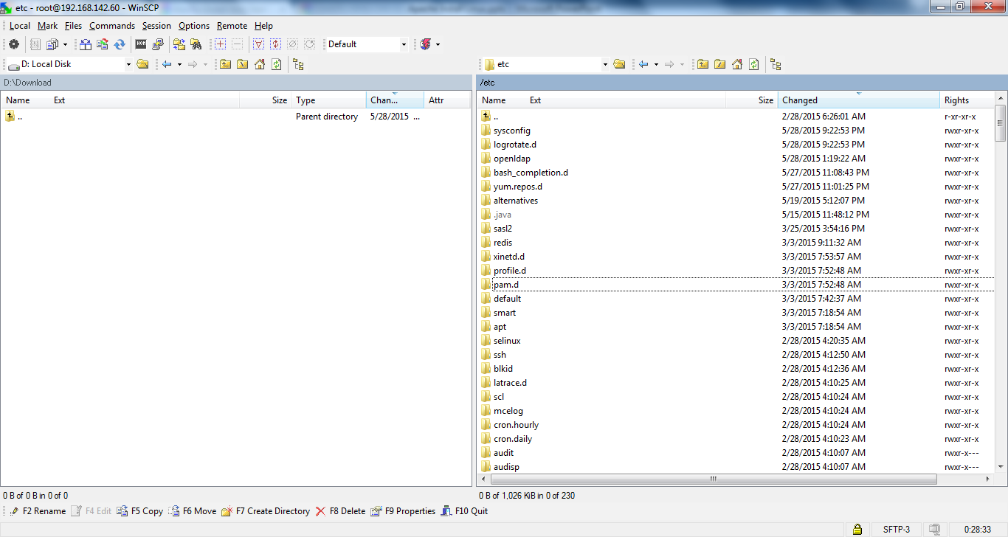
Apache Installation
Before install Apache or Httpd Service, No httpd folder is present

Slide 2
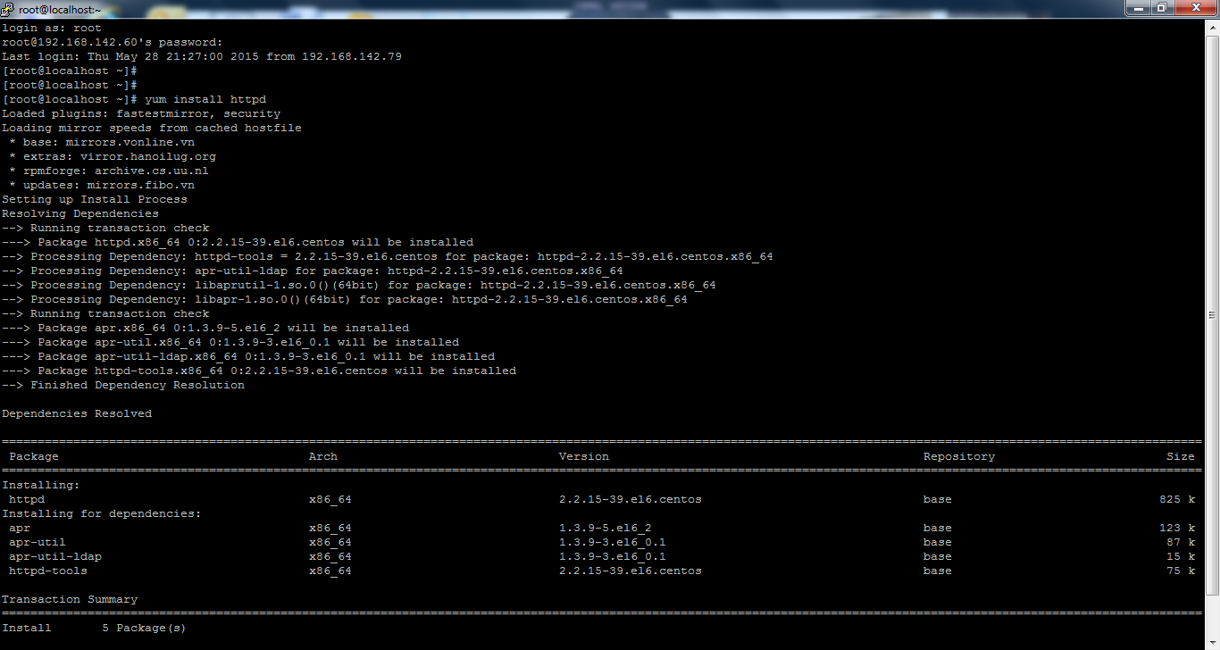
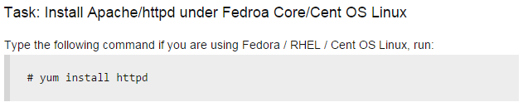
Apache Installation

Slide 3
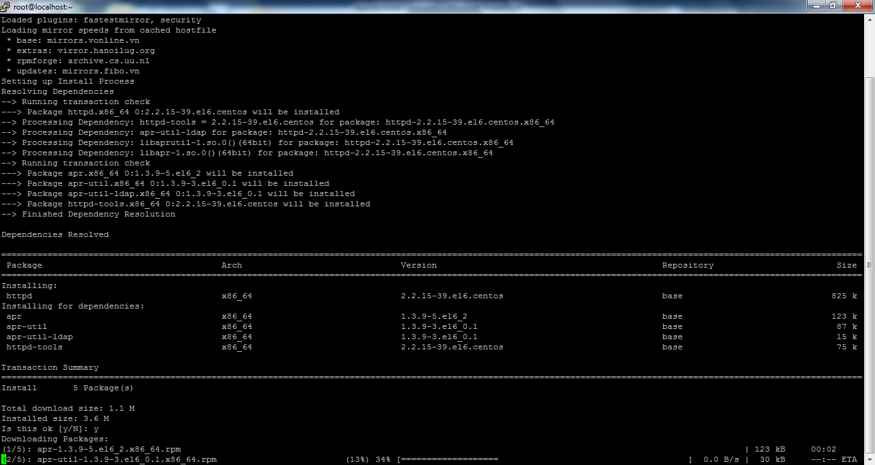
Apache Installation

Slide 4
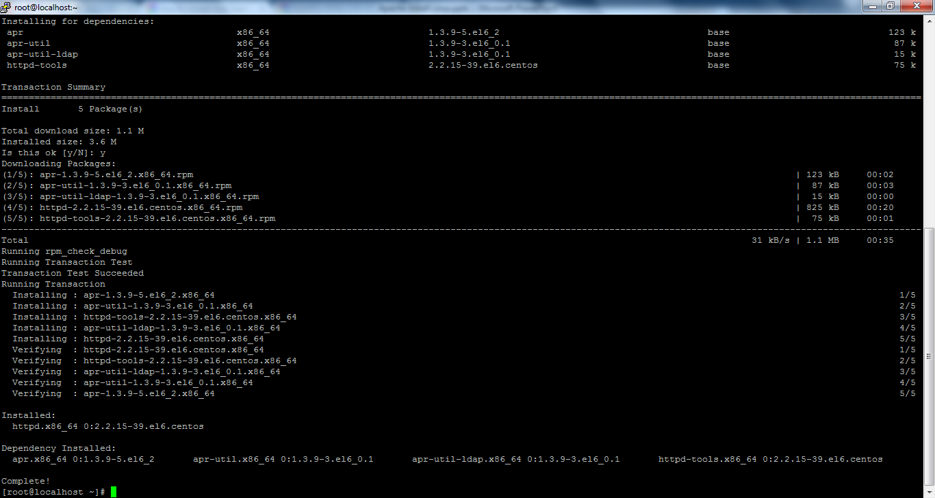
Apache Installation
Installation of Apache or Httpd Service is completed.

Slide 5
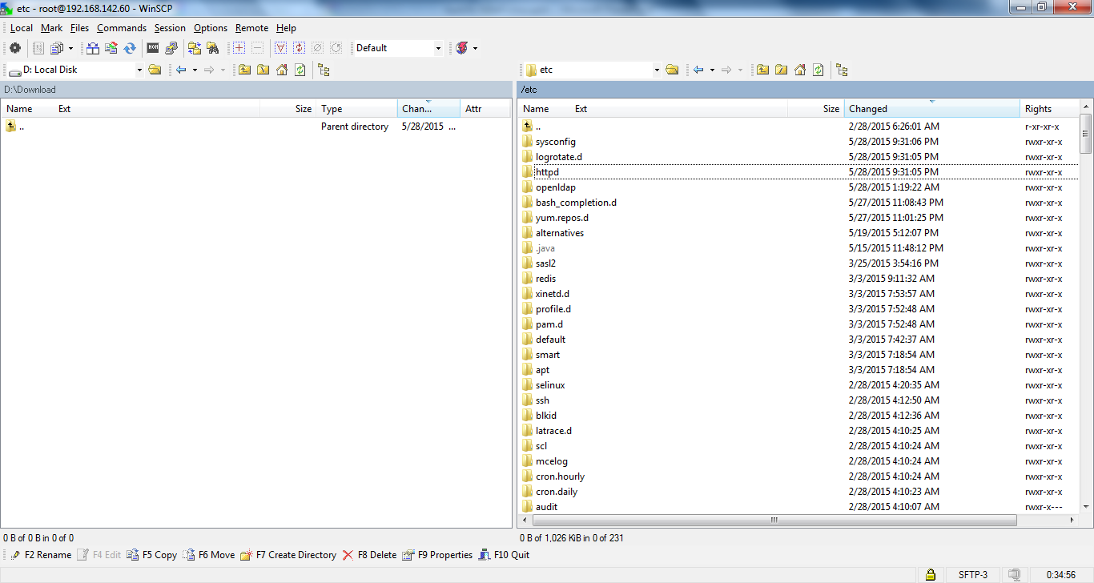
Apache Installation
After install Apache or Httpd Service, httpd folder is present

Slide 6
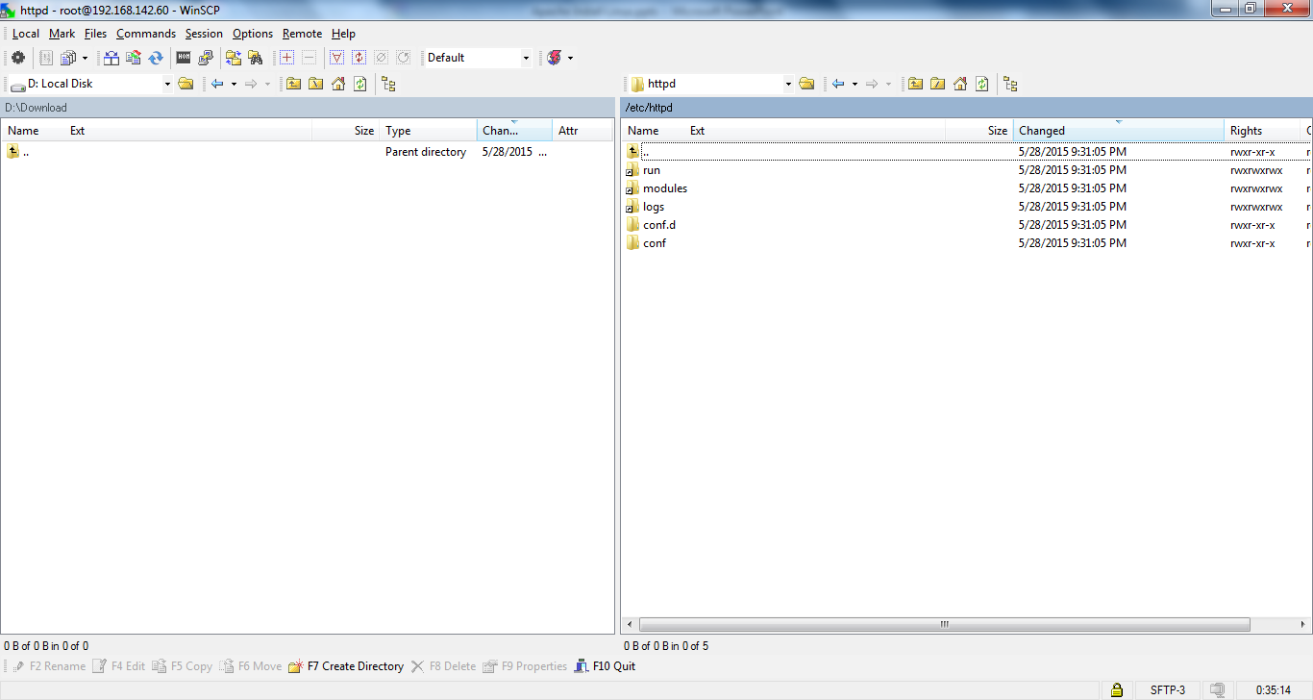
Apache Installation
After install Apache or Httpd Service, httpd folder is present

Slide 7
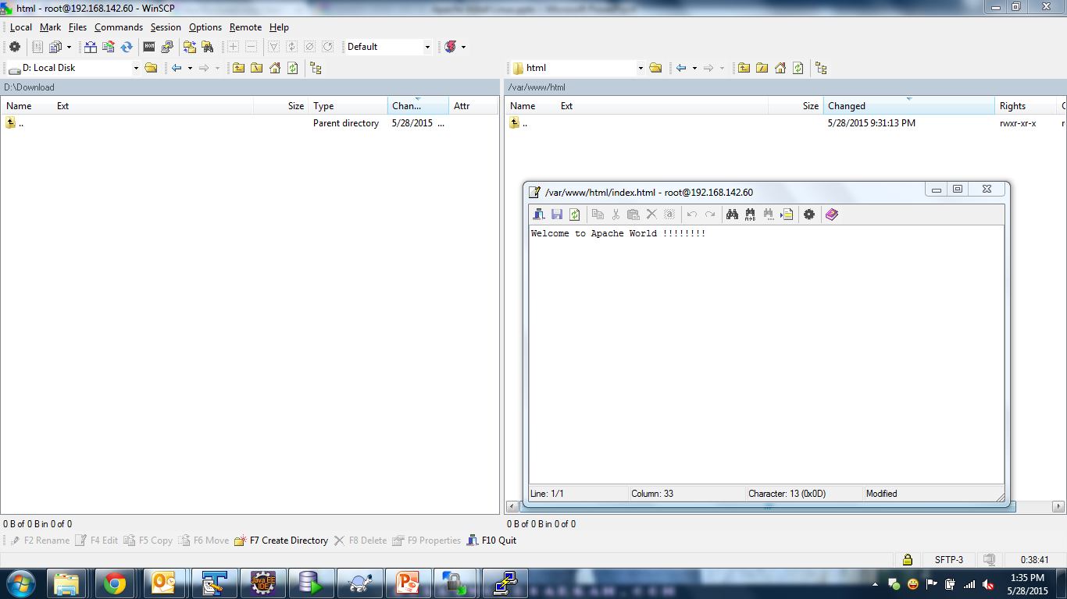
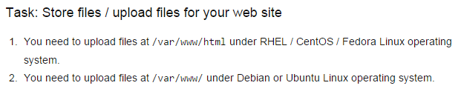
Apache Installation
Create index.html inside ‘/var/www/html ’ folder.

Slide 8
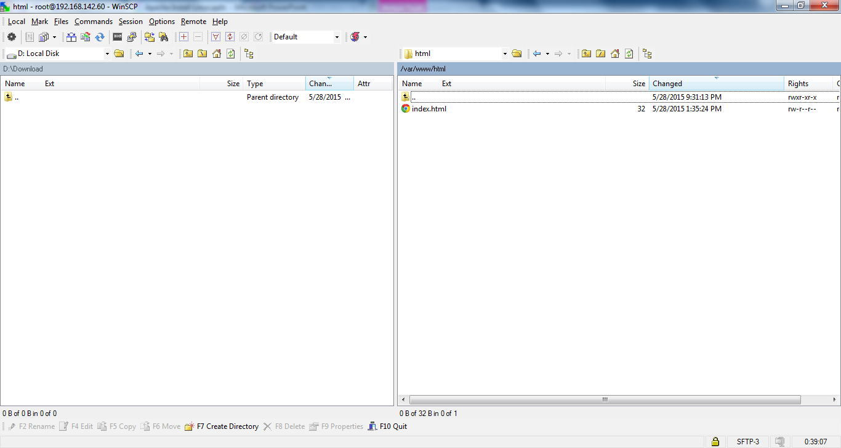
Apache Installation
Create index.html inside ‘/var/www/html ’ folder.

Slide 9
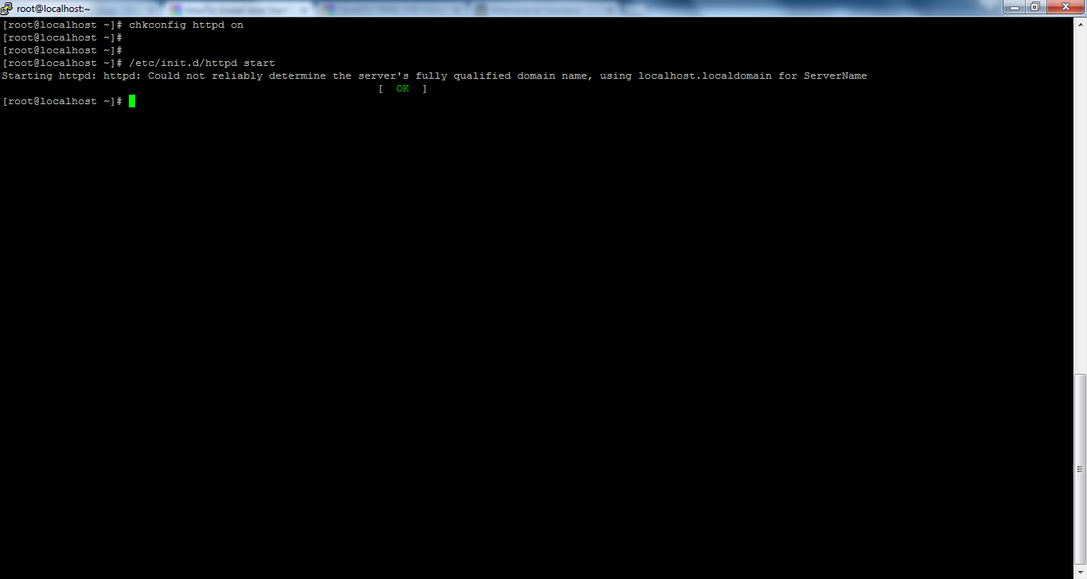

Apache Installation

Slide 10
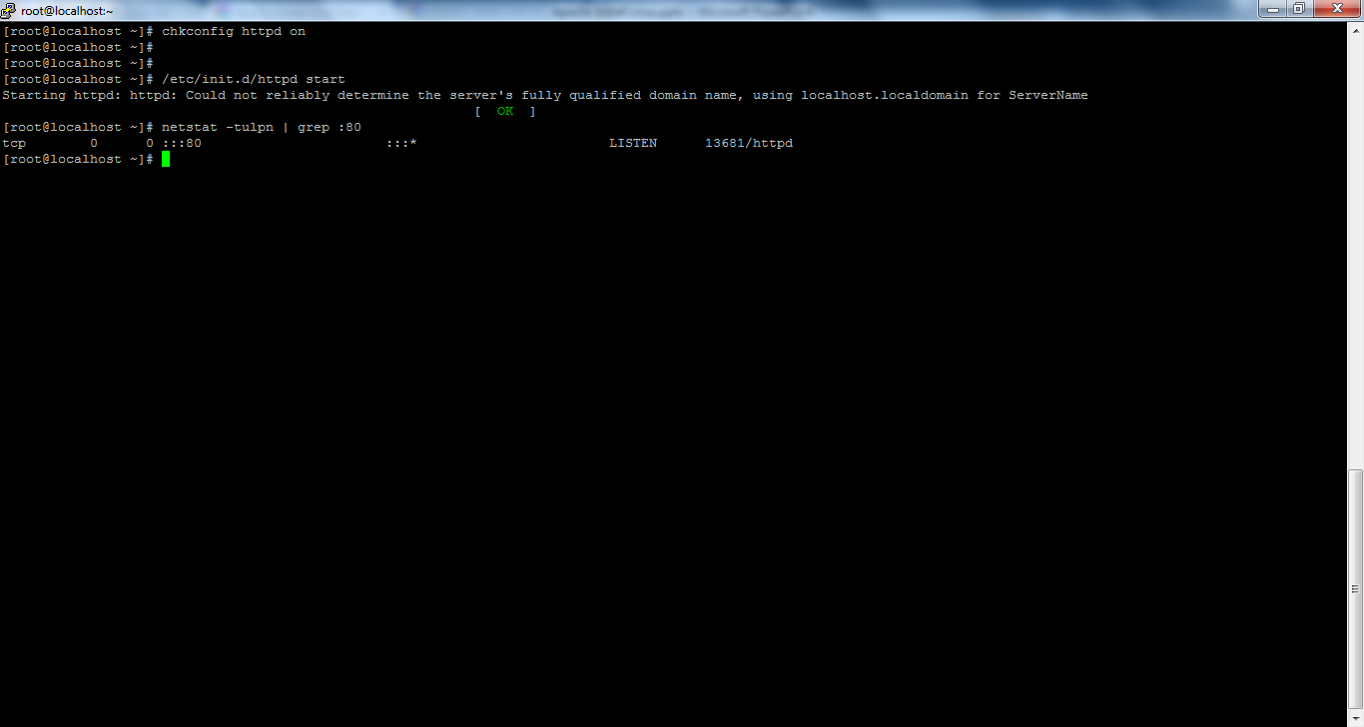
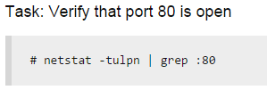
Apache Installation

Slide 11

Apache Installation
Check the Apache server is running or not

Slide 12

Apache Installation
Apache server is running and we got Welcome message.

Slide 13
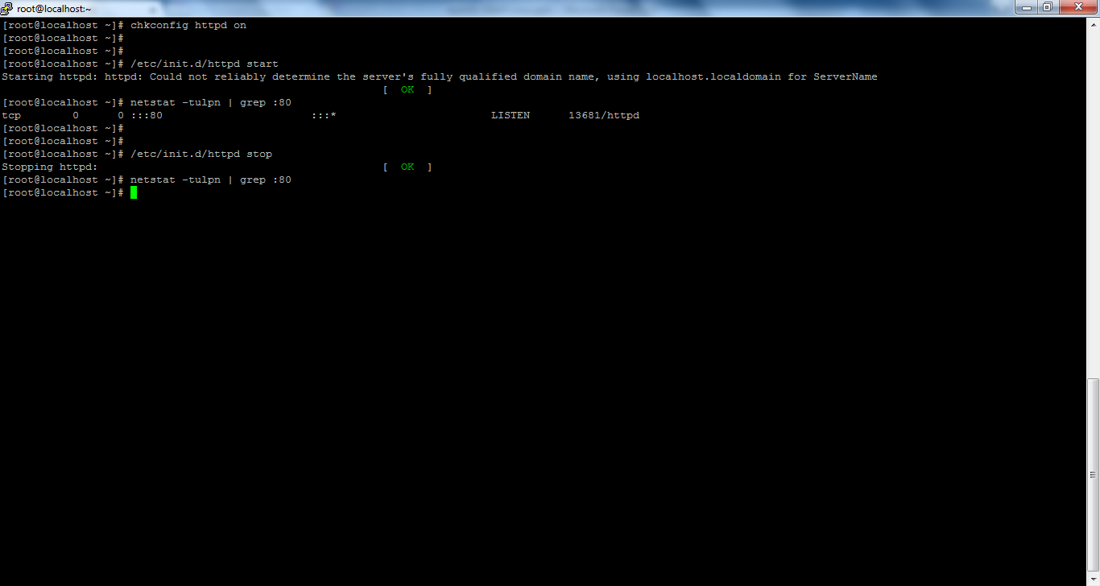
Apache Installation
To stop Apache Server.

Slide 14
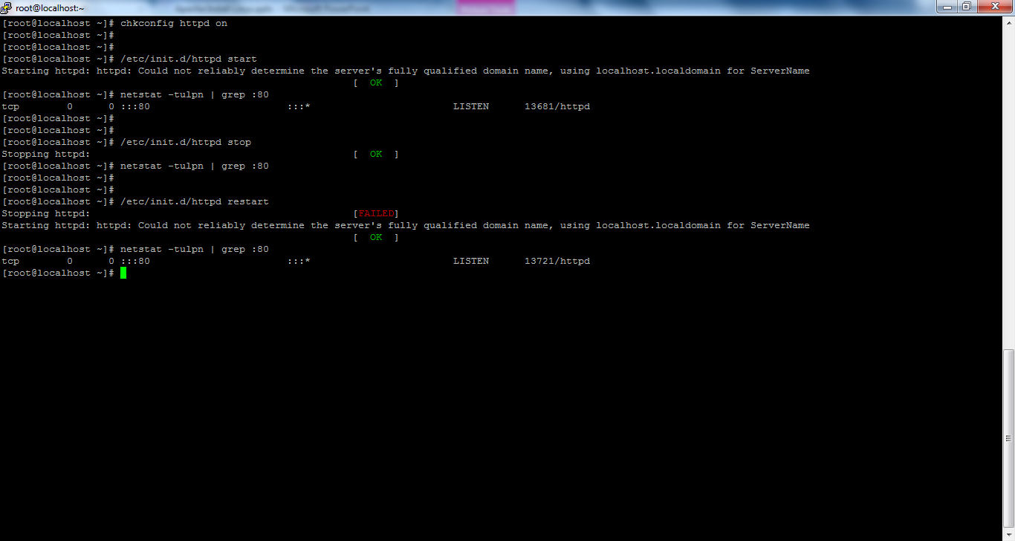
Apache Installation
To restart Apache Server.

Slide 15
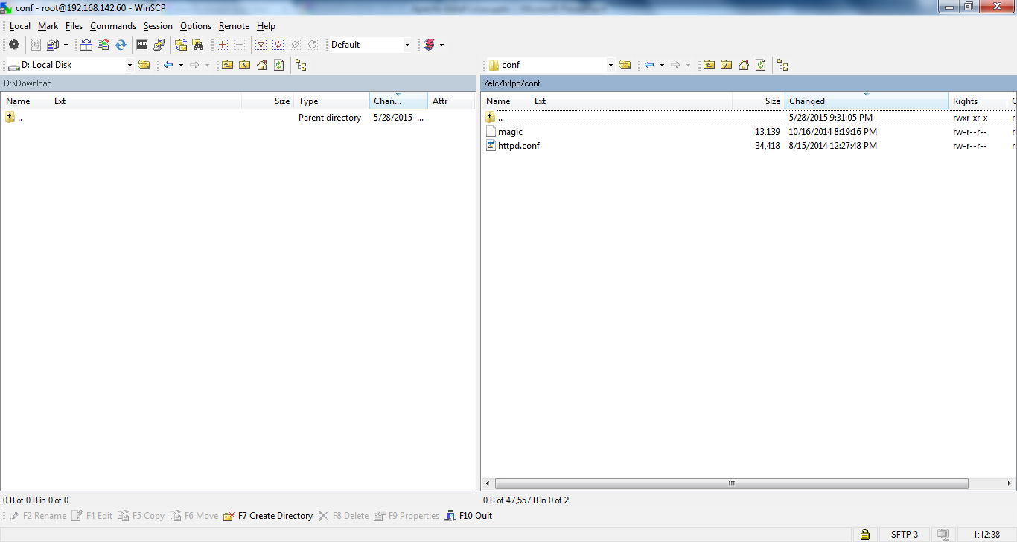
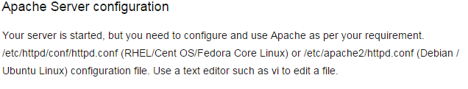
Apache Installation

Slide 16
Apache Installation
# yum install httpd
# chkconfig httpd on
# /etc/init.d/httpd start
# netstat -tulpn | grep :80
# /etc/init.d/httpd stop
# /etc/init.d/httpd restart

Slide 17
Apache Installation
http://www.cyberciti.biz/faq/linux-install-and-start-apache-httpd/

